Slide 1
Certification Program in
Business Analytics & Optimisation
From IITD
Data Driven Case Study 2
From:
Shivesh Kumar Sareen
shivesh72@gmail.com

Slide 2
Objective: Develop a ML model to Determine the flight prices based on available inputs
Airfares are constantly fluctuating now more than ever. That's because airlines have access to better technology and more real-time information on passengers than ever before.
With complex algorithms running their booking systems, the airlines are constantly monitoring and updating prices based on shifts in demand or available seats.
Ticket bookings play an integral role for the airlines. With increasing competition, it becomes even more critical to optimize the flight ticket price or else it might cost them a customer.
On the other hand, passengers are always waiting for a booking window, where they can get the best deal.
In this case study, we have tried to develop a ML model based on Decision Tree algorithm.

Slide 3
Steps for implementation of code
Step 1: Importing Libraries : Certain libraries like Numpy, Pandas and Matplotlib needs to be imported to carry out data pre-processing.
Step 2: Loading the dataset : Dataset which is a (.csv) file needs to be loaded in Python.
Step 3: Defining the variables : Input and output parameters need to be defined.
Step 4: Encoding categorical data : For the current dataset, ONE HOT ENCODING has to be used for input variables and Label Encoding for output variables.
Step 5: Splitting the dataset : To develop a machine learning model, dataset needs to be divided into training and test data. Bigger the dataset, more is the training data, better is the accuracy of the model.
Step 6: Developing the Decision Tree model using Python
Step 7: Evaluating the model using Accuracy score and F1 score.

Slide 4
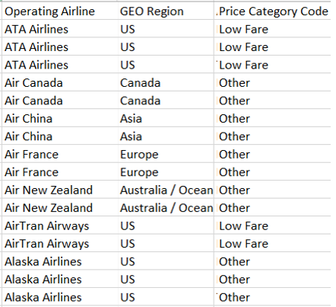
Understanding the concept of ONE HOT ENCODING
This is a snapshot of the dataset, to show how ONE HOT ENCODING will be applied in current case study
Input Variables
One Hot Encoding will be applied. Current column will be replaced with a column containing 0/1.
For operating flights, there are 7 varieties, so (n-1) = 6, new columns will be made.
For GEO region, there are 5 varieties, so (n-1) = 4, new columns will be made.
Output Variables
Label Encoding will be applied. Current column will be replaced with a column containing 0/1.
1→ Low Fair
0→ Other

Slide 5
Sample code
# Importing the libraries
import numpy as np
import matplotlib.pyplot as plt
import pandas as pd
# Importing the dataset
dataset = pd.read_csv(‘Air_Traffic_Passenger_Statistics.csv')
# Defining the variables
X = dataset.iloc[:, 1,3].values
y = dataset.iloc[:, 5].values
print(X)
print(y)
# Encoding categorical data
# Encoding the Independent Variable
from sklearn.compose import ColumnTransformer
from sklearn.preprocessing import OneHotEncoder
ct = ColumnTransformer(transformers=[('encoder', OneHotEncoder(), [0])], remainder='passthrough')
X = np.array(ct.fit_transform(X))
print(X)
Libraries are imported in Python
Datasets which are to be studied are imported in Python

Slide 6
# Encoding the Dependent Variable
# Encoding the Dependent Variable
from sklearn.preprocessing import LabelEncoder
le = LabelEncoder()
y = le.fit_transform(y)
print(y)
# Splitting the dataset into the Training set and Test set
from sklearn.model_selection import train_test_split
X_train, X_test, y_train, y_test = train_test_split(X, y, test_size = 0.2, random_state = 1)
print(X_train)
print(X_test)
print(y_train)
print(y_test)
tree_model = DecisionTreeClassifier(max_depth = 4, criterion = 'entropy')
tree_model.fit(X_train, y_train)
tree_yhat = tree_model.predict(X_test)
print('ACCURACY SCORE')
print('Accuracy score of the Decision Tree model is {}'.format(accuracy_score(y_test, tree_yhat)))
print('F1 SCORE')
print('F1 score of the Decision Tree model is {}'.format(f1_score(y_test, tree_yhat)))

Slide 7
Conclusion
OUTPUT :
ACCURACY SCORE
Accuracy score of the Decision Tree model is 0.983269150203598
F1 SCORE
F1 score of the Decision Tree model is 0.8105263157894738
From the above results, its clear that the developed model has a very good accuracy score i.e. 98.3%
This signifies, that the input variables considered play an important role in determination of flight prices, i.e. operating airline, location (of the airport).

Slide 8
THANK YOU

